Slide 1
Lecture 5
Python Basics

Slide 2
Learning Objectives Today
Python Variables
Data Types
String
Casting
List
Tuple
Dictionary
Operators

Slide 3
Python Variables
age = 30
name = "Alice"
pi = 3.14159
Variables are often described as boxes you can store values in.

Slide 4
Variable Features
Redeclaration
Multiple Assignment
num1 = 5
num1 = 3.45
num1, num2, stri = 4, 5, "okay"
num1 = num2 = num3 = 10
print(num1, num2, num3)

Slide 5
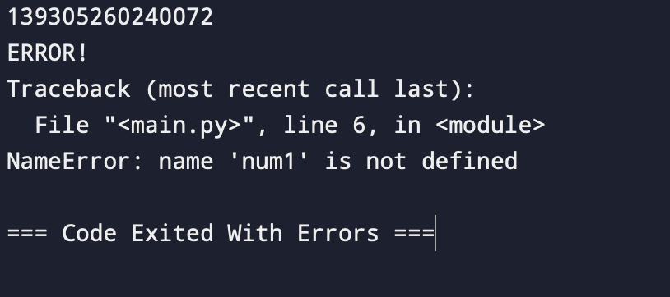
Delete Variable
Num1 = 10
print(id(num1)) #Shows the RAM location where this is saved
del num1
print(num1)

Slide 6
Python Data Types
Numeric Types:
Integers (int): Represent whole numbers, positive or negative (e.g., age = 30, score = -10).
Floats (float): Represent decimal numbers (e.g., pi = 3.14159, temperature = 25.5).
Complex Numbers (complex): (e.g., z = 3+5j).
Text Types:
Strings (str): Represent sequences of characters, enclosed in single or double quotes (e.g., name = "Alice", message = 'Hello, world!').
Sequence Types:
Lists (list): Ordered, mutable collections of items (e.g., fruits = ["apple", "banana", 10]).
Tuples (tuple): Ordered, immutable collections of items (e.g., coordinates = (10, 20))
Set Types:
Sets (set): Unordered collections of unique items enclosed in curly braces {}. Useful for checking membership and removing duplicates (e.g., unique_numbers = {1, 2, 2, 3, 4}).
Frozen Sets (frozenset): Immutable versions of sets (e.g., frozen_numbers = frozenset({1, 2, 3})).
Mapping Types:
Dictionaries (dict): Unordered collections of key-value pairs enclosed in curly braces {}. Keys must be unique and immutable (e.g., person = {"name": "Bob", "age": 30}).
Other Types:
Boolean (bool): Represent logical values, True or False (e.g., is_running = True).

Slide 7
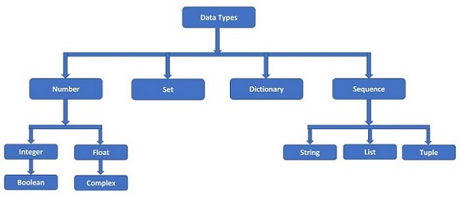
Data Types

Slide 8
Try Out
Input a number and print
Input a number 1451.1545 into the variable and output only two decimal values
Take two strings and an integer. Print a single string.
Multiple Variable Assignment
Delete a variable

Slide 9
Casting
x = float(1) # x will be 1.0
y = float(2.8) # y will be 2.8
z = float("3") # z will be 3.0
w = float("4.2") # w will be 4.2
print(x)
print(y)
print(z)
print(w)
x = str("s1") # x will be 's1'
y = str(2) # y will be '2'
z = str(3.0) # z will be '3.0'
print(x)
print(y)
print(z)
x = int(1)
y = int(2.8)
z = int("3")
print(x)
print(y)
print(z)
Implicit Type Casting (Automatic Conversion)
Explicit Type Casting (Manual)

Slide 10
String Formatting and Functions
message = 'Hello, world!' # Single quotes
name = "Alice" # Double quotes
multiline_text = """This is a string
that spans multiple lines.""" # Triple quotes
print(multiline_text)

Slide 11
String
Accessing Characters
first_letter = message[0] # 'H'
last_letter = message[-1] # '!’
print(first_letter, last_letter)
Slicing
Extract substrings using colon (:) notation within square brackets.
Syntax: [start:end:step].
message = "PythonClass"
substring = message[1:6] # "world" (extracts characters from index 6 to 10)
print(substring)
substring = message[1:8:2] # "world" (extracts characters from index 6 to 10)
print(substring)

Slide 12
Try Out
A Dataset contains strings in a column. The last character of the sentence contains the currency type. And 5th,6th, and 7th letters contain the amount of money. Can you extract it?

Slide 13
String
Strings provide various built-in methods for manipulation:
upper(): Convert to uppercase (e.g., message.upper()).
lower(): Convert to lowercase (e.g., message.lower()).
strip(): Remove leading and trailing whitespaces (e.g., message.strip()).
find(substring): Find the index of the first occurrence of a substring (returns -1 if not found).
replace(old, new): Replace all occurrences of a substring with another substring.
Many more! (Refer to Python documentation for the full list)

Slide 14
Try Out
Apply the functions and see what happens to the string.

Slide 15
String Formatting
name = "Bob"
age = 30
formatted_text = f"Hello, {name}! You are {age} years old."
print(formatted_text) # Output: Hello, Bob! You are 30 years old.
Try OUT

Slide 16
String Space Removal
message = " Hello, World! "
# Remove all leading/trailing whitespaces
stripped_message = message.strip()
print(stripped_message) # Output: Hello, World!
# Remove leading whitespaces
left_stripped_message = message.lstrip()
print(left_stripped_message) # Output:Hello, World!
# Remove trailing whitespaces
right_stripped_message = message.rstrip()
print(right_stripped_message) # Hello, World!

Slide 17
String Search
message = "Hello, brave new world!"
# Find the index of the first occurrence of "world"
world_index = message.find("world")
print(world_index) # Output: 7
# Find the index of the last occurrence of "world" (if it appears multiple times)
last_world_index = message.rfind("world")
print(last_world_index) # Output: 7

Slide 18
String Split and Join
message = "Hello, how are you today?"
# Split the string into words using spaces as separator
words = message.split(" ")
print(words) # Output: ['Hello,', 'how', 'are', 'you', 'today?']
message2 = "I am Atanu $ I'm taking your class"
words = message2.split("$")
print(words) # Output: ['Hello,', 'how', 'are', 'you', 'today?']
# Join the words back into a string with underscores
joined_message = "_".join(words)
print(joined_message) # Output: Hello,_how,_are,_you,_today?

Slide 19
String Replacement
message = "Hi, this is a test string."
# Replace all occurrences of "is" with "was"
replaced_message = message.replace("is", "was")
print(replaced_message) # Output: Hi, this was a test string.
# Replace only the first occurrence
replaced_message = message.replace("is", "was", 1)
print(replaced_message) # Output: Hi, this was a test string.

Slide 20
Try Out
You are given a list of strings representing words. Your task is to write a Python program that performs the following operations:
Join all the words in the list into a single string, separated by a specific delimiter.
Split the resulting string back into individual words using the same delimiter.
Write a Python function join_split_words(words_list, delimiter) that takes a list of words and a delimiter as input and returns the list of words obtained after joining and splitting the original list.
Input:
words_list: A list of strings representing words (e.g., ["Hello", "World", "Python"])
delimiter: A string representing the delimiter to use for joining and splitting (e.g., ",")
Output:
A list of strings obtained after joining and splitting the original list using the specified delimiter.

Slide 21
Try Out
Example
words_list = ["Hello", "World", "Python"]
delimiter = ","
result = join_split_words(words_list, delimiter)
print(result)
Expected Output:
['Hello', 'World', 'Python’]
Lets t
okay lets try formating Hello, can you see World ry formatted output????????????

Slide 22
Lists vs Array in Python
The main differences are:
Arrays can only store elements of the same data type, while lists can store mixed data types.
Arrays are more memory-efficient and faster for numerical operations, while lists consume more memory but are more flexible.
Arrays require explicitly importing the array module, while lists are a built-in data structure in Python.
Arrays have limited functionality compared to the extensive list of built-in methods available for lists.
Modifying the size of an array is more difficult than modifying a list, which can be done dynamically.

Slide 23
Lists vs Array in Python
Choosing Between Lists and Arrays:
General purpose collection: Use lists for general-purpose data storage where you might have different data types and need flexibility in adding, removing, or modifying elements.
Numerical computations: If you're working with large amounts of numerical data and need efficient operations, consider using arrays from NumPy. NumPy arrays offer a powerful set of functions for numerical computations and vectorized operations.
Additional Considerations:
For simple numerical arrays, the array module can be an option, but NumPy provides a richer set of features and optimizations.
If you don't need the performance benefits of arrays for numerical data, lists are generally more convenient due to their built-in nature and flexibility.

Slide 24
List
List is one of the built-in data types in Python. A Python list is a sequence of comma separated items, enclosed in square brackets [ ]. The items in a Python list need not be of the same data type.
list1 = ["Rohan", "Physics", 21, 69.75]
list2 = [1, 2, 3, 4, 5]
list3 = ["a", "b", "c", "d"]
list4 = [25.50, True, -55, 1+2j]

Slide 25
List
#Access
list1 = ['physics', 'chemistry', 1997, 2000];
list2 = [1, 2, 3, 4, 5, 6, 7 ];
print ("list1[0]: ", list1[0])
print ("list2[1:5]: ", list2[1:5])
#Update
list = ['physics', 'chemistry', 1997, 2000];
print ("Value available at index 2 : ")
print (list[2])
list[2] = 2001;
print ("New value available at index 2 : ")
print (list[2])

Slide 26
List
#Delete
list1 = ['physics', 'chemistry', 1997, 2000];
print (list1)
del list1[2];
print ("After deleting value at index 2 : ")
print (list1)
Negative Access??
bicycles = ['trek', 'cannondale', 'redline', 'specialized’]
print(bicycles[-1])

Slide 27
List
Insert vs Append
bicycles.append("Duranta")
print(bicycles)
bicycles.insert(3, "Racer")
print(bicycles)

Slide 28
Try Out
Insert, Append in a Python List
Delete values from a list
Search and delete a value from a Python list
Search and delete all occurances of a value from the list
Solutions are in the python scripts of lecture 5

Slide 29
List
Slice and PoP
fruits = ["apple", "banana", "cherry"]
sublist = fruits[1:3] # ["banana", "cherry"] (extracts elements at index 1 and 2, excluding index 3)
print(sublist)
removed_fruit = fruits.pop(2) # removed_fruit is "cherry" and fruits becomes ["apple", "orange", "mango"]
print(removed_fruit)

Slide 30
List Functions
Sort
my_list = [66, 33, 22, 44, 88, 77, 99, 11]
my_list2 = sorted(my_list)
print(my_list2)
my_list.sort()
print(my_list)

Slide 31
List Functions
Sort
numbers = [3, 1, 4, 2]
numbers.sort()
print(numbers) # Output: [1, 2, 3, 4]
numbers.sort(reverse=True)
print(numbers) # Output: [4, 3, 2, 1]
# Sorting by length of strings
strings = ["aa", "bbbbb", "ccc"]
strings.sort(key=len)
print(strings) # Output: ["aa", "ccc", "bbbbb"]

Slide 32
List Functions
Reverse, Length and Extend
my_list.reverse()
print(my_list)
print(len(my_list))
fruits = ["apple", "banana"]
fruits.append("cherry")
print(fruits) # Output: ["apple", "banana", "cherry"]
vegetables = ["potato", "tomato"]
fruits.extend(vegetables)
print(fruits) # Output: ["apple", "orange", "banana", "cherry", "potato", "tomato"]

Slide 33
List Functions
Min, max, in, copy
new_fruits = fruits.copy()
new_fruits.append("mango")
print(fruits) # Output: ["apple", "banana", "cherry"] (original list is not modified)
print(new_fruits) # Output: ["apple", "banana", "cherry", "mango"]
is_mango_in_fruits = "mango" in fruits
print(is_mango_in_fruits) # Output: False
numbers = [5, 1, 8, 2]
smallest = min(numbers)
print(smallest) # Output: 1
numbers = [5, 1, 8, 2]
largest = max(numbers)
print(largest) # Output: 8

Slide 34
List Access
magicians = ['alice', 'david', 'carolina']
for magician in magicians:
print(magician)
magicians = ['alice', 'david', 'carolina']
for magician in magicians:
print(f"{magician.title()}, that was a great trick!")

Slide 35
Numerical List
for value in range(1, 5):
print(value)
print("Append to list")
list = []
for value in range(1, 5):
list.append(value)
print(list)

Slide 36
List
Looping through a slice or sublist
players = ['charles', 'martina', 'michael', 'florence', 'eli', 'atanu', 'jacob']
print("Here are the first three players on my team:")
for player in players[2:5]:
print(player.title())

Slide 37
Try Out
Python program to find unique numbers in a given list.
Python program to create a list of 5 random integers.
Write a Python program that takes a list of numbers as input and returns a new list containing only the even numbers.
Imagine, one list contains fruit names [‘banana’, ‘mango’] and another one contains number of fruits [10,25]. Arrange them in a new list such a way that [‘banana’, 10, ‘mango’, ‘25’]

Slide 38
Try Out
Write a Python program that takes a list containing duplicate elements and returns a new list with the duplicates removed, sorted in ascending order.
Write a Python program that takes a list and an element as input and returns the index of the first occurrence of the element in the list, or -1 if the element is not present.

Slide 39
Tuple
In Python, a tuple is an ordered collection of items that are similar to lists. However, unlike lists, tuples are immutable, which means you cannot modify their elements after they are created.
my_tuple = ("apple", "banana", "cherry")

Slide 40
Tuple
Ordered: Tuples maintain the order in which you add elements.
Immutable: Once created, you cannot change the elements within a tuple.
Heterogeneous: Tuples can store elements of different data types.
Duplicates: Tuples allow duplicate elements within the collection.

Slide 41
Tuple
#Creation
my_tuple = ("apple", "banana", "cherry")
print(my_tuple)
# List to Tuple
my_list = ["apple", "banana", "cherry"]
my_tuple = tuple(my_list)
print(my_tuple)

Slide 42
Tuple
Access
my_tuple = ("apple", "banana", "cherry")
first_fruit = my_tuple[0] # first_fruit will be "apple"
print("Single Element",first_fruit)
for fruit in my_tuple:
print(fruit)

Slide 43
Tuple
Can’t modify
dimensions = (200, 50)
dimensions[0] = 250 #Error
Reassign is possible
dimensions = (400, 33)

Slide 44
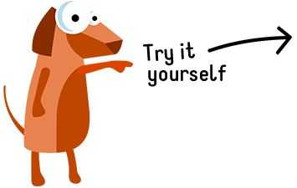
Tuple Functions
Min, Max, Length, Sorted, In, Concatenation

Slide 45
Dictionary
Python dictionaries are another fundamental data structure used to store collections of data. Unlike lists that use numerical indexes, dictionaries use key-value pairs for accessing elements.
Properties of Dictionaries:
Unordered: The order in which you add key-value pairs to a dictionary is not preserved.
Changeable: You can modify or remove elements after creating a dictionary.
Heterogeneous Keys: Keys can be of various data types (strings, numbers, tuples). Keys must be unique within a dictionary.
Values can be Duplicated: Values can have duplicate data within the dictionary.

Slide 46
Dictionary
#Declare
alien_0 = {'color': 'green', 'points': 5}
print(alien_0['color'])
print(alien_0['points'])
my_dict = dict(name="Bob", age=25)
print(my_dict)

Slide 47
Dictionary
#Access
my_dict = {"name": "Alice", "age": 30, "city": "New York"}
name = my_dict["name"] # name will be "Alice"
#Add or modify
my_dict = {"name": "Alice", "age": 30}
my_dict["city"] = "New York" # Adding a new key-value pair
my_dict["age"] = 31 # Modifying an existing value
print(my_dict)

Slide 48
Dictionary Usage
if my_dict["age"]<31:
print("Not too old")
elif my_dict["age"] == 31:
print("About to be to buira")
else:
print("Definitely Buro manush")

Slide 49
Dictionary
favorite_languages = {
'jen': 'python',
'sarah': 'c',
'edward': 'rust',
'phil': 'php',
}
print(favorite_languages['jen'])
del favorite_languages['jen']
print(favorite_languages)

Slide 50
Dictionary
Not found
var1 = favorite_languages.get("sarah")
print(var1)
var1 = favorite_languages.get("atanu", "not found")
print(var1)

Slide 51
Dictionary
Looping through data
for k, v in favorite_languages.items():
stri = f"Key {k} and value is {v}"
print(stri)
#Only keys
for k in favorite_languages.keys():
print(k)

Slide 52
Dictionary
Sorted Access
for k in sorted(favorite_languages.keys()):
print(k)
List in dictionary?
pizza = {
'crust': 'thick',
'toppings': ['mushrooms', 'extra cheese'],
}
for k, v in pizza.items():
print(f"Key is {k} and value is {v}")

Slide 53
Try Out
Write a Python program that takes a dictionary as input and returns a new dictionary where the keys and values are swapped. If there are duplicate values, the new key should be the first occurrence of the value.
input_dict = {"name": "Alice", "age": 30, "city": "New York"}
# Potential Output: {30: 'age', 'New York': 'city', 'Alice': 'name'}

Slide 54
Try Out
Create a phonebook application using dictionaries. The dictionary can store contact information where keys are names (strings) and values are dictionaries containing details like phone number (string) and email address (string, optional). Write functions to:
Add a new contact to the phonebook.
Search for a contact by name and display their details.
Update the contact information for an existing contact.
Delete a contact from the phonebook.

Slide 55
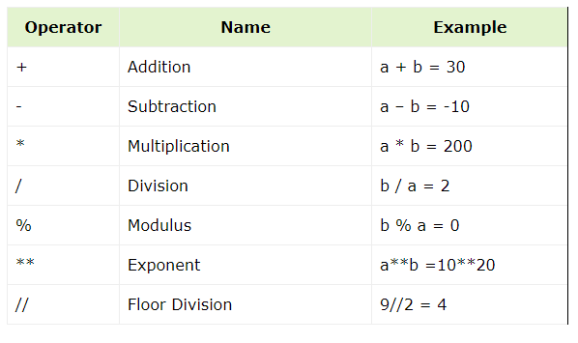
Python Operators (Arithmatic)

Slide 56
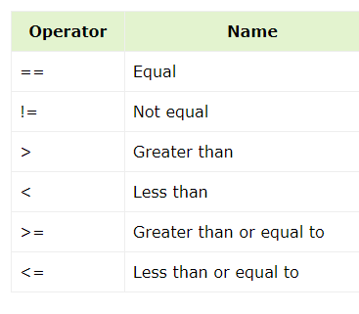
Python Operators (Comparison)

Slide 57
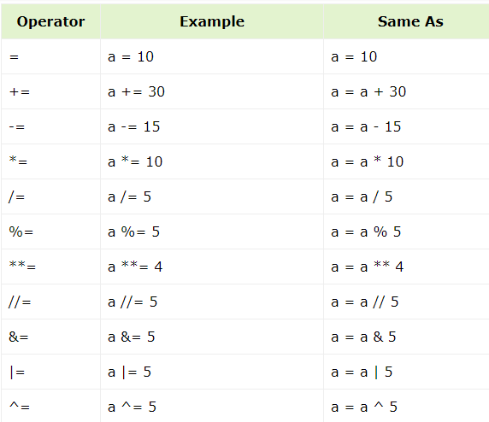
Python Operators (Assignment)

Slide 58
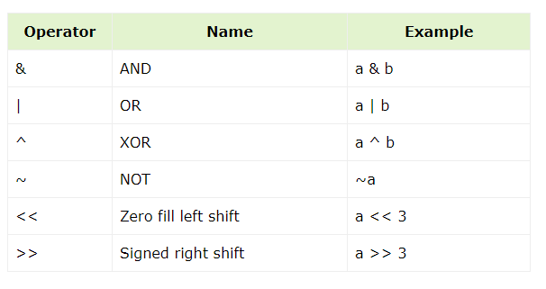
Python Operators (Bitwise)

Slide 59
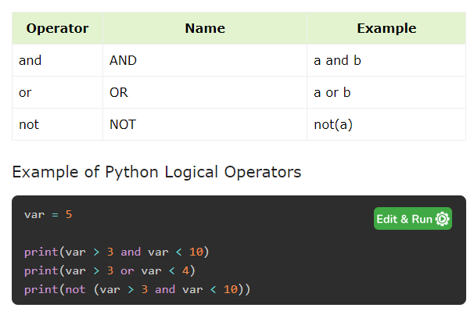
Python Operators (Logical)

Slide 60
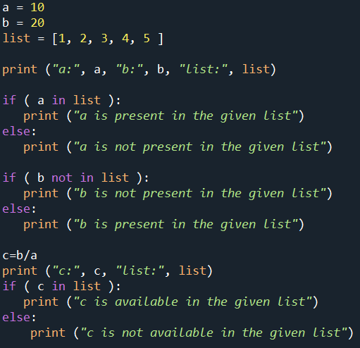
Python Operators (In and Not-in)

